Slide 1
8 puzzle Problem using Branch And Bound
“Algorithms”
8 Puzzle

Slide 2


Green University of Bangladesh
Dr. Faiz Al Faisal
Sajid Rhman Rifan
Assistant Professor & Associate Chairperson of CSE Department for GUB
ID:212902017
Department of CSE
“Sir”

Slide 3
01
02
Introduction
Objective
Table of contents
04
05
Discribe
Solutions &Implementation
03
Tools

Slide 4
01
Introduction
8 PUZZLE

Slide 5
Objective
02
An 8 puzzle is a simple game consisting of a 3 x 3 grid

Slide 6


Using branch & boucd with cost funcation (live, dead,E-Node)
03
Tools

Slide 7
Discribe
04
C(X) = g(X) + h(X)

Slide 8
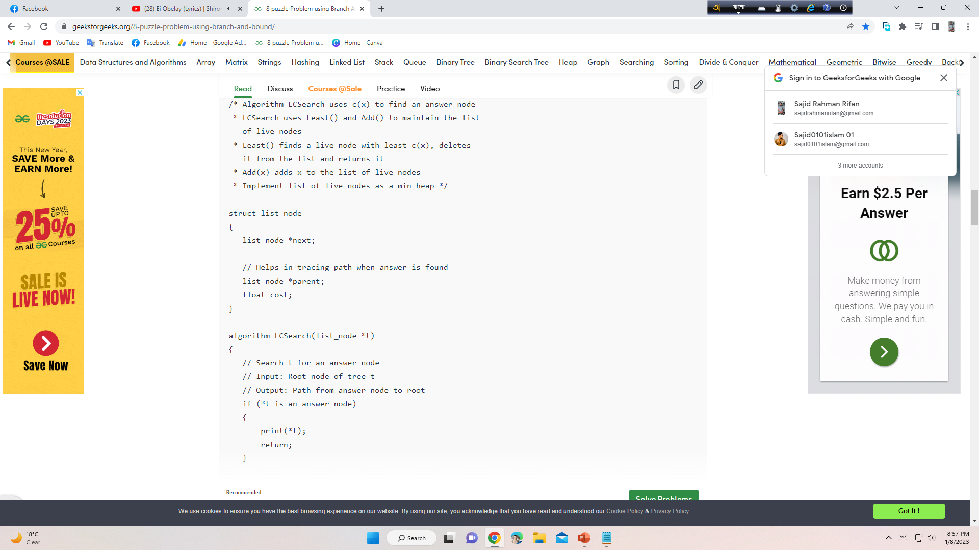
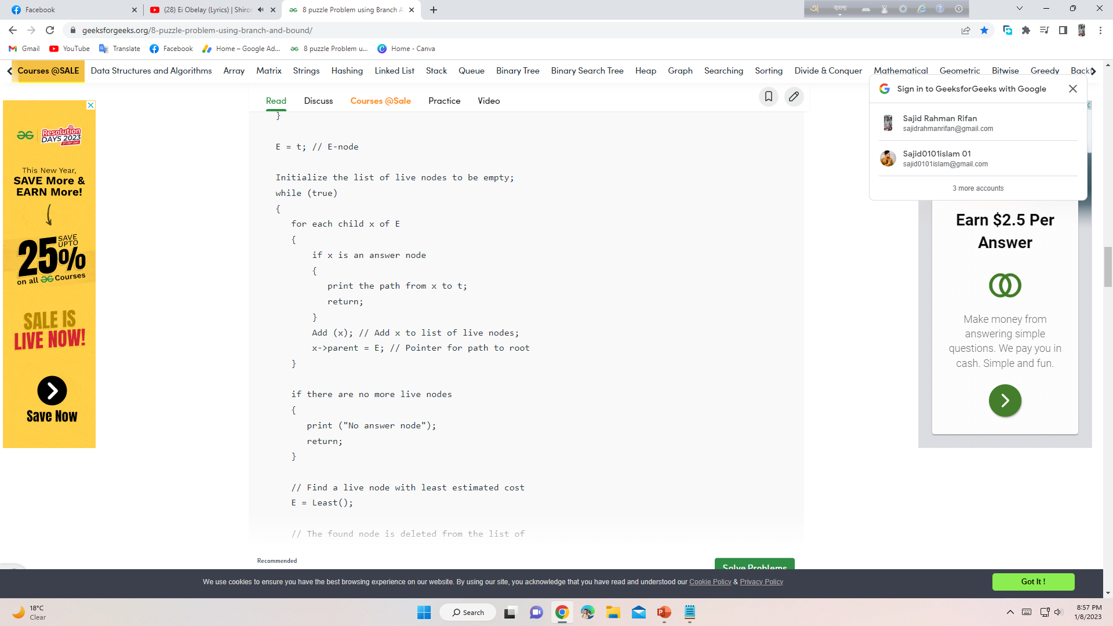
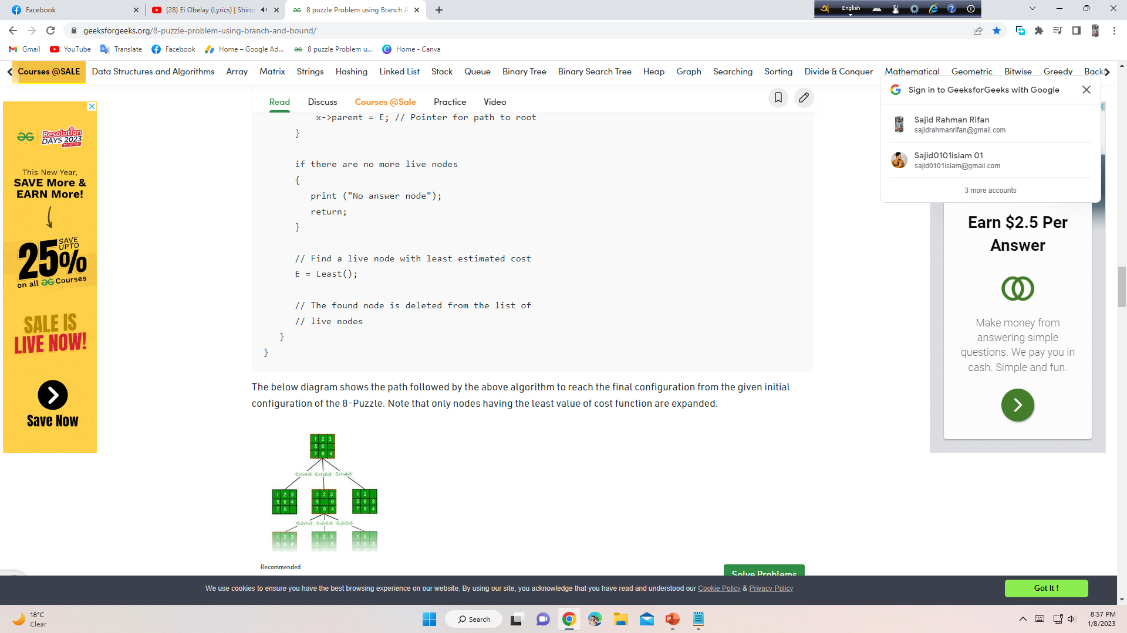
Solutions & Implementation
05
Algorithms -

Slide 9
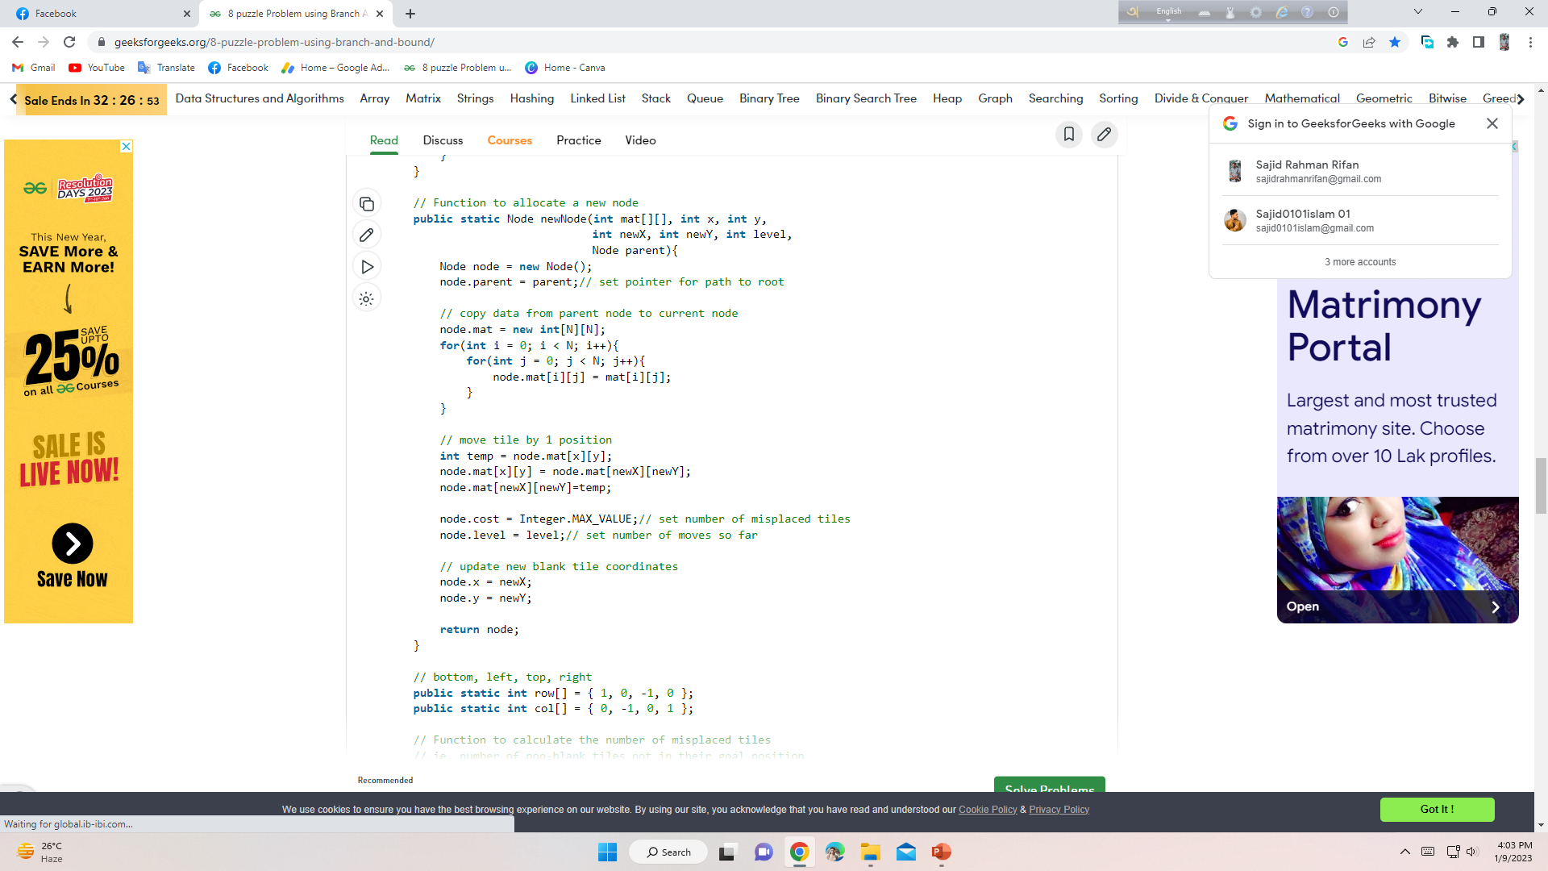
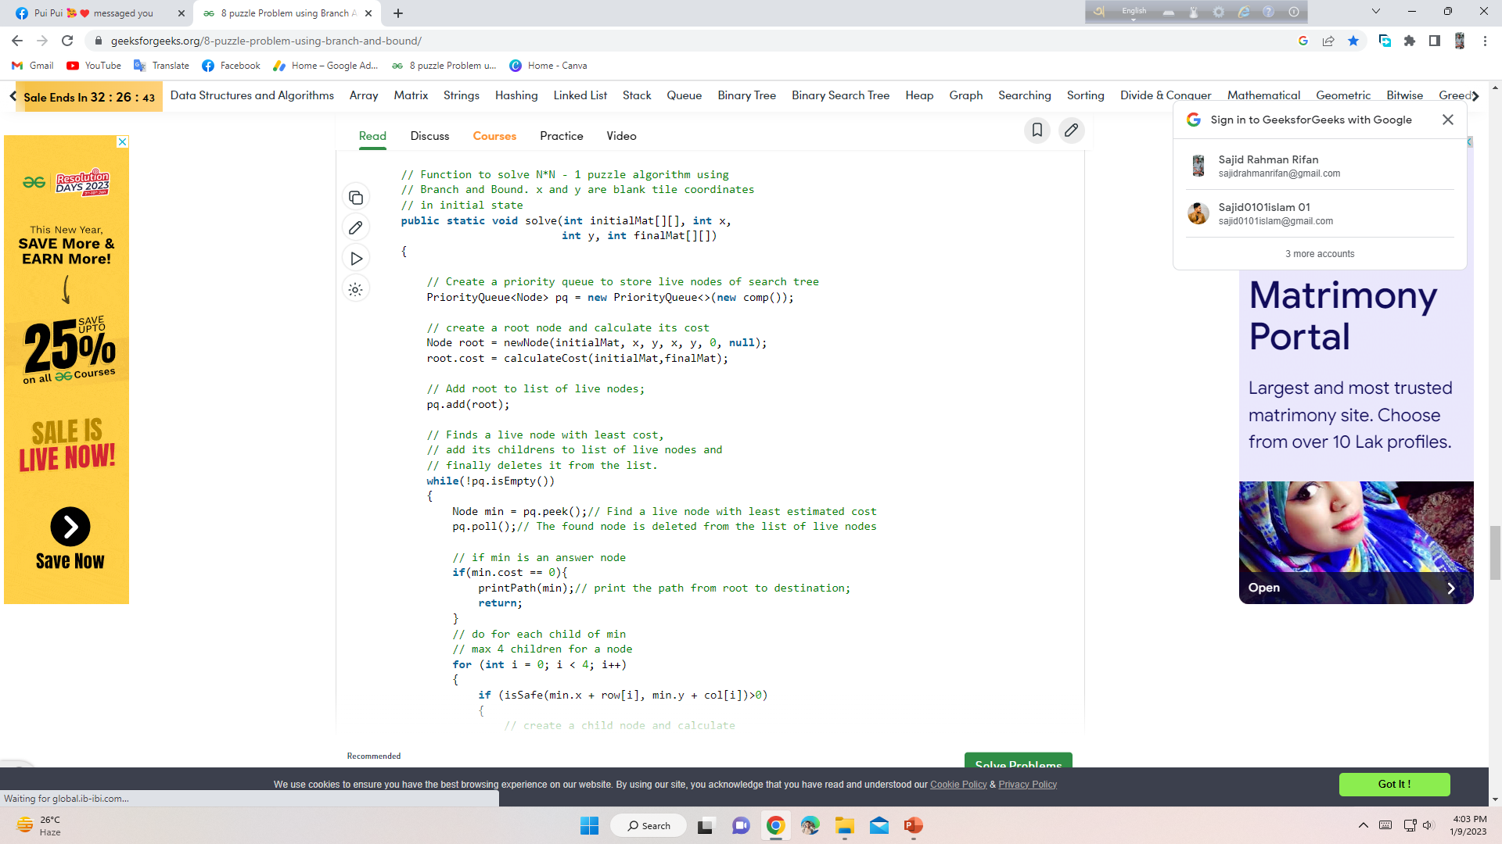



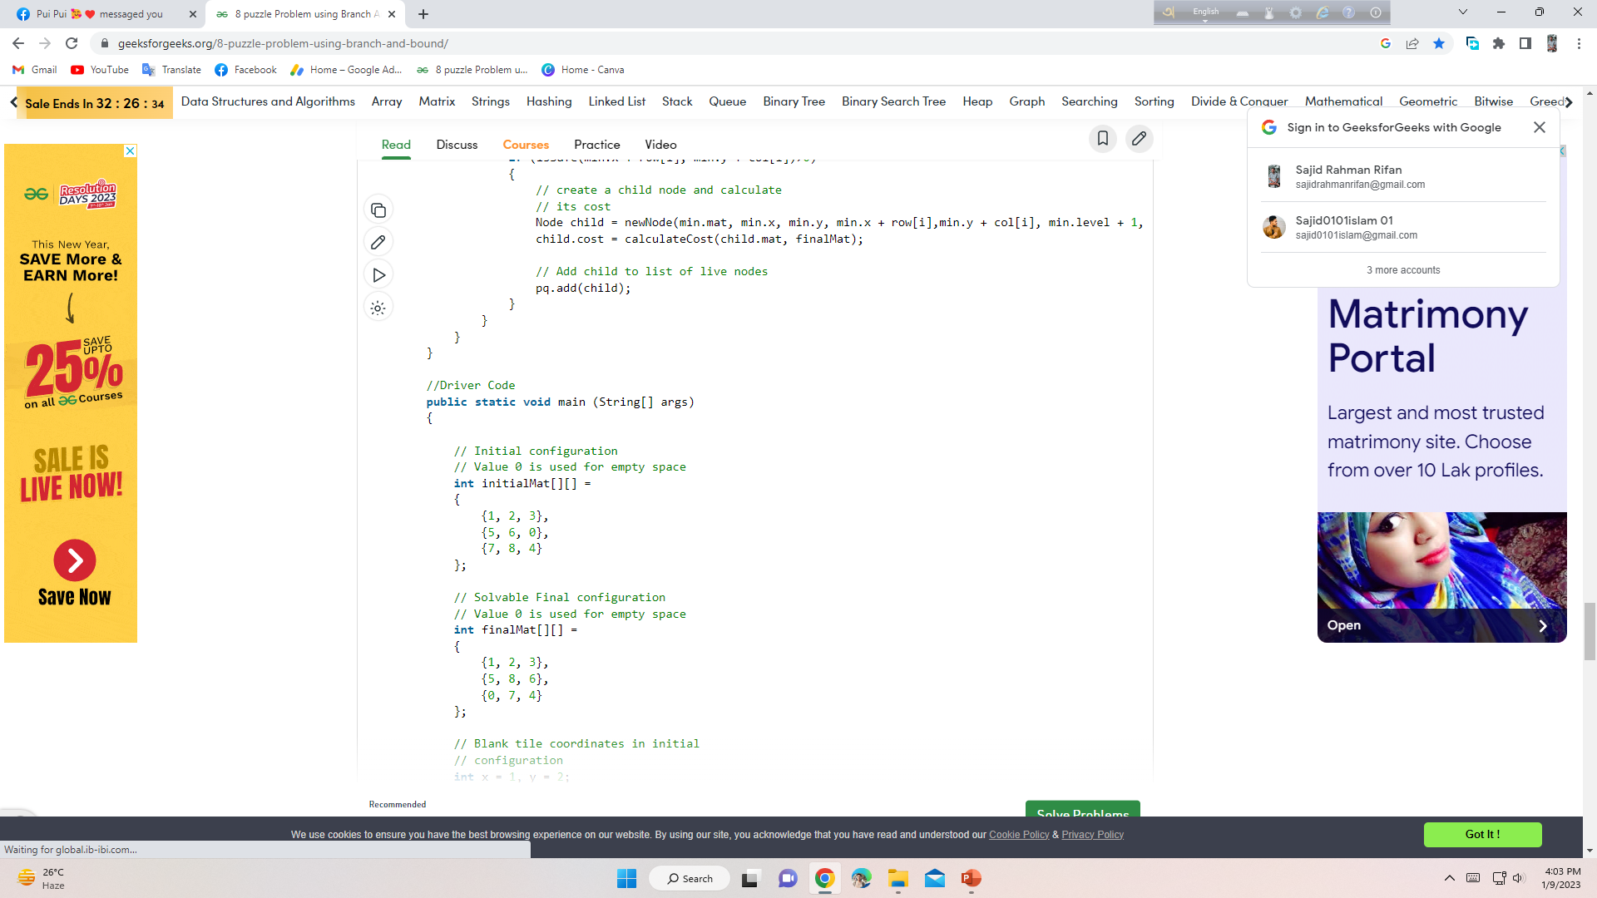
Solutions & Implementation
Code-

Slide 10
Thank You

